Slide 1
Renormalization Group Theory & Sine-Gordon Model
Mariana Malard

Slide 2
Renormalization Group Theory & Sine-Gordon Model
SUMMARY OF THE LECTURES
Lecture 4
January 28th
Finish from last lecture: Kosterlitz-Thouless Phase Diagram
Gap

Slide 3
Spin Lattices, Spin Waves, Non-linear Sigma Model
SUMMARY OF THE LECTURES
Lecture 5
January 30th
Conceptual overview.
Spin-wave theory.
Break-down of spin-wave theory for D = 1 antiferromagnets.
Mapping onto the non-linear sigma model (time permitting).

Slide 4
Kosterlitz-Thouless Phase Diagram
At this critical scale, interactions become too strong, i.e. strong enough to win over the kinetic term in H.
Past this scale, R.G. is no longer valid.
System undergoes a phase transition from gapless to gapped bosons.
Bosons become trapped at the cosine minima.
u
l_{c}
1
x
.
.
.
.
.
.
.
.
.
.
.
.
.
.
.
.
.
.
.
.
K
0
1
The critical correlation length decreases as one goes deeper inside the strong coupling regime.

Slide 5
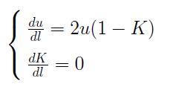
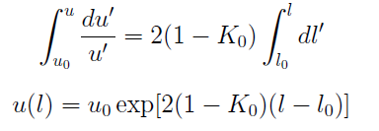
Kosterlitz-Thouless Phase Diagram
Gap
long (short) critical scale
↓
small (large) gap
What is the value of l_{c} ?
Flow equations up to first order in u:

Slide 6
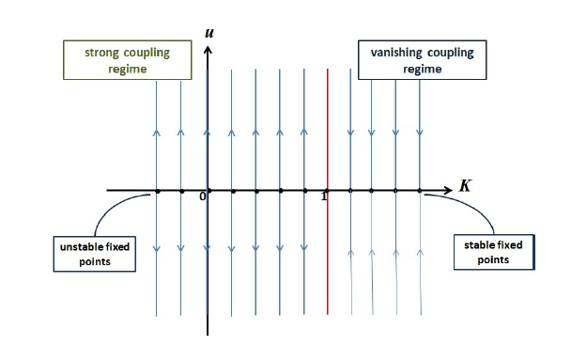
Kosterlitz-Thouless Phase Diagram
Gap
First-order flow diagram:
$$K\left(l\right)=K_{0}$$

Slide 7
Kosterlitz-Thouless Phase Diagram
Gap
Critical scale:
with$\left|u_{0}\right|<1$and $K_{0}≤1$
1st order gap:

Slide 8
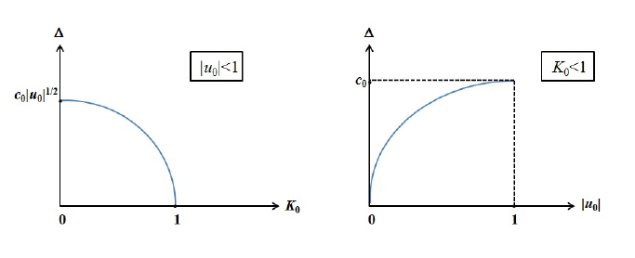
Kosterlitz-Thouless Phase Diagram
Gap
The critical correlation length decreases, as thus the gap becomes larger, as one goes deeper inside the strong coupling regime.

Slide 9
Kosterlitz-Thouless Phase Diagram
Gap
gapped
gapless
Phase transition

Slide 10
Kosterlitz-Thouless Phase Diagram
Gap
Approximation to 2nd order gap:
gapped
gapless
1

Slide 11
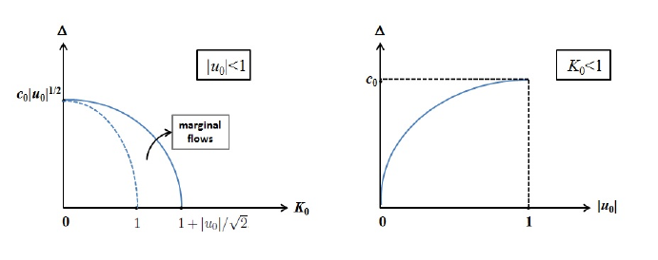
Kosterlitz-Thouless Phase Diagram
Gap

Slide 12
Kosterlitz-Thouless Phase Diagram
Homework
Find some experimental papers on realizations of Kosterlitz-Thouless phase transitions in one-dimensional interacting electron systems, both for the charge sector (Umklapp scattering needed) and for the spin sector (backscattering needed).

