Slide 1
Renormalization Group Theory & Sine-Gordon Model
Mariana Malard

Slide 2
Renormalization Group Theory & Sine-Gordon Model
SUMMARY OF THE LECTURES
Lecture 1
January 16th
Renormalization Group Theory
Conceptual overview.
General procedure 0: Define a field theory Action.
General procedure I: Decompose in slow and fast modes.
General procedure II: Expressing δS in terms of Green’s functions.

Slide 3
Renormalization Group Theory & Sine-Gordon Model
SUMMARY OF THE LECTURES
Lecture 2
January 21st
Renormalization Group Theory
Finish general procedure II: Expressing δS in terms of Green’s functions.
General procedure III: Averaging in the fast modes’ ground state.
Sine-Gordon Model
Conceptual overview.
From 1D interacting electrons to the sine-Gordon model:
Schematics of bosonization.
The model.

Slide 4
Renormalization Group Theory & Sine-Gordon Model
SUMMARY OF THE LECTURES
Lecture 3
January 23rd
Sine-Gordon Model
Re-scaled Action for the sine-Gordon model.
Renormalization group flows equations of the sine-Gordon model.
Kosterlitz-Thouless Phase Diagram
Gap

Slide 5
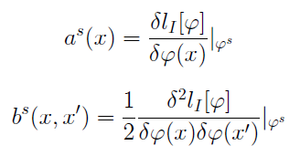
Sine-Gordon Model
Re-scaled Action for the sine-Gordon model
Effective residual Action for the slow modes:
Substitute a^{s} and b^{s} and compute the integrals. Loooong calculation. See review paper.

Slide 6
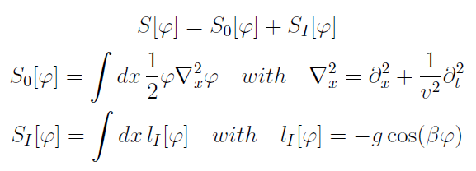
Sine-Gordon Model
Re-scaled Action for the sine-Gordon model
Effective Action for the slow modes:

Slide 7
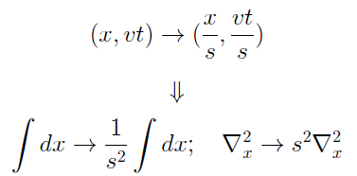
Sine-Gordon Model
Re-scaled Action for the sine-Gordon model
Re-scaled Action:
Back to the original scale

Slide 8
Sine-Gordon Model
Re-scaled Action for the sine-Gordon model
Re-scaled Action:

Slide 9
Sine-Gordon Model
Renormalization group flow equations of the sine-Gordon model
The phylosophy is:
Full theory
Average with respect to the fast modes’ ground state
Effective theory for the slow modes
Re-scale the theory back to the full cutoff Λ
Flow equations
Compare
Renormalized theory

Slide 10
Sine-Gordon Model
Renormalization group flow equations of the sine-Gordon model
Renormalized parameters:

Slide 11
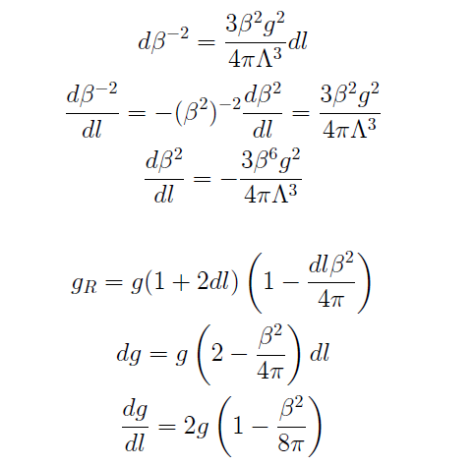
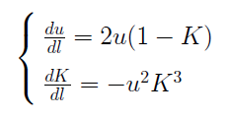
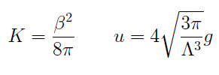
Sine-Gordon Model
Renormalization group flow equations of the sine-Gordon model
Flow equations:
$$s^{−2}=1+2dl+O({dl}^{2})$$

Slide 12
Sine-Gordon Model
Renormalization group flow equations of the sine-Gordon model
Flow equations:
u = 0: du/ dl = dK/ dl = 0 ⇒ No flow. Line of fixed points.
Flow of u :
u
u > 0, K < 1: du/ dl > 0 ⇒ upward flow
u > 0, K > 1: du/ dl < 0 ⇒ downward flow
u < 0, K < 1: du/ dl < 0 ⇒ downward flow
u < 0, K > 1: du/ dl > 0 ⇒ upward flow
K
1
Any u ≠ 0, K = 1: du/ dl = 0 (but dK/ dl ≠ 0 ) ⇒ horizontal flow

Slide 13
Sine-Gordon Model
Renormalization group flow equations of the sine-Gordon model
Flow equations:
Flow of k :
Any u ≠ 0, K > 0: dK/ dl < 0 ⇒ backward flow
u
Any u ≠ 0, K < 0: dK/ dl > 0 ⇒ forward flow
Any u ≠ 0, K = 0: dK/ dl = 0 (but du/ dl ≠ 0 ) ⇒
vertical flow
K
1

Slide 14
Sine-Gordon Model
Renormalization group flow equations of the sine-Gordon model
Flow equations:
u
u
1
K
K
1
u
1
K

Slide 15
Sine-Gordon Model
Renormalization group flow equations of the sine-Gordon model
Kosterlitz-Thouless phase-diagram
u
.
.
.
.
.
.
.
.
.
.
.
.
.
.
.
.
.
.
.
.
K
0
1

Slide 16
Kosterlitz-Thouless Phase Diagram
For K ~ 1. See review paper.
The expression inside parenthesis is an invariant.

Slide 17
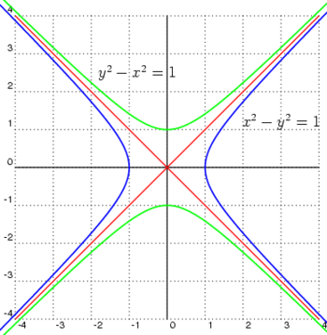
Kosterlitz-Thouless Phase Diagram
Family of hiperbolae characterized by the sign of c.

Slide 18
Kosterlitz-Thouless Phase Diagram
c > 0 : Flows outside the separatrices
u
c = 0 : Separatrices
c < 0 : Flows enclosed by the separatrices
c < 0 : Flows enclosed by the separatrices
.
.
.
.
.
.
.
.
.
.
.
.
.
.
.
.
.
.
.
.
K
0
1
c > 0 : Flows outside the separatrices

Slide 19
Kosterlitz-Thouless Phase Diagram
opens up a gap (mass)
bosons remain gapless (massless)
u
marginally relevant interaction
strongly relevant interaction
irrelevant interaction
.
.
.
.
.
.
.
.
.
.
.
.
.
.
.
.
.
.
.
.
K
0
1
unstable fixed points
stable fixed points

Slide 20
Kosterlitz-Thouless Phase Diagram
At this critical scale, interactions become too strong, i.e. strong enough to win over the kinetic term in H.
Past this scale, R.G. is no longer valid.
System undergoes a phase transition from gapless to gapped bosons.
Bosons become trapped at the cosine minima.
u
l_{c}
1
x
.
.
.
.
.
.
.
.
.
.
.
.
.
.
.
.
.
.
.
.
K
0
1

Slide 21
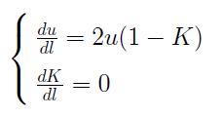
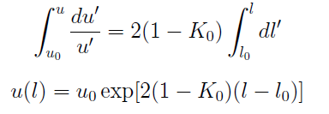
Kosterlitz-Thouless Phase Diagram
Gap
long (short) critical scale
↓
small (large) gap
What is the value of l_{c} ?
Flow equations up to first order in u:

